Slide 1

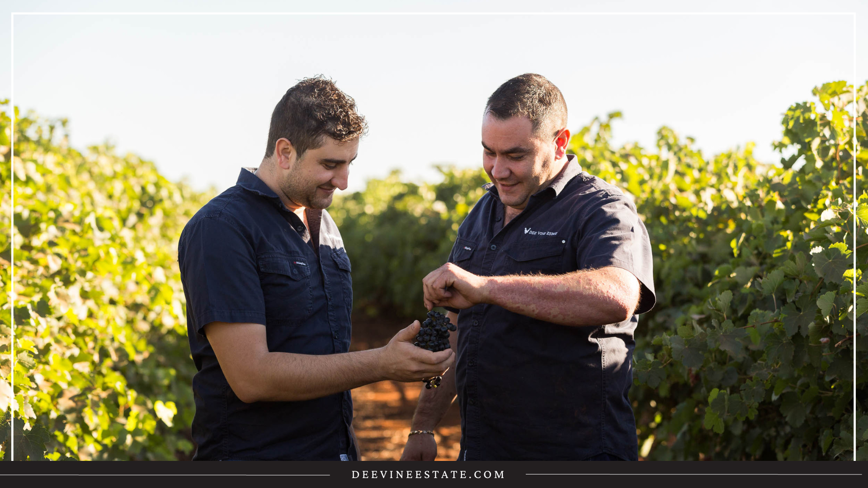


Slide 2
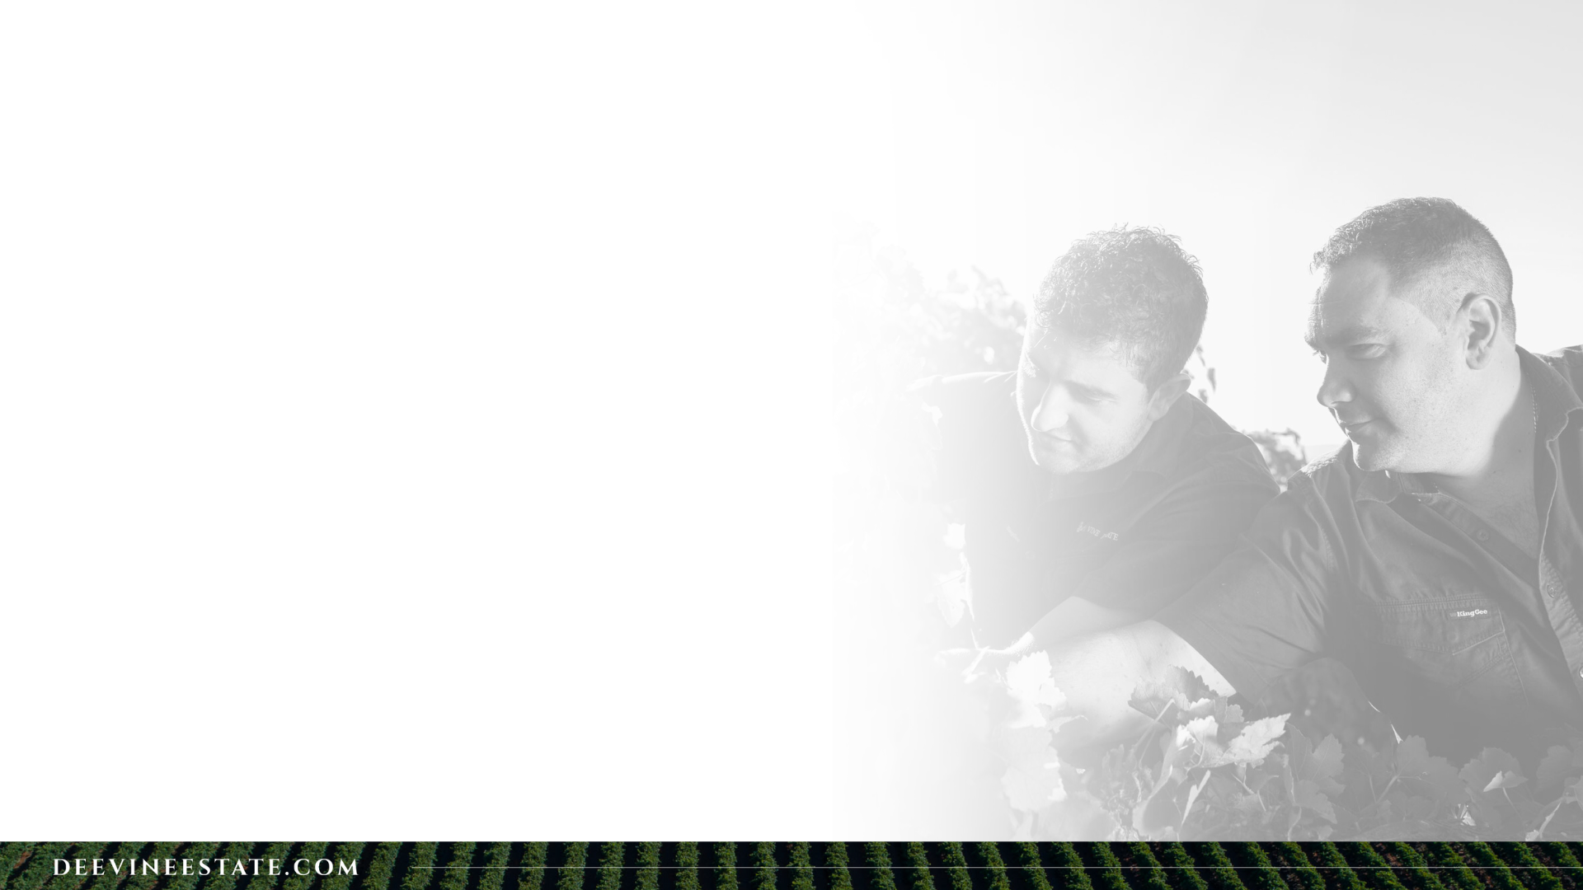
Our Story
Dee Vine Estate is a winery established from the traditional family vineyards of Michele and Domenico Scarfone, two brothers that emigrated from Southern Italy in 1956 to settle at Nericon within the Riverina area of Australia.
They planted the first vines on the property the following year with the vision of producing traditional Italian table wine for the Australian wine drinker.
Three generations later Adrian Bianchini and Fernando Rombola have significantly expanded from their grandfathers original parcel of land, but follow the same principles; a passion for fine wine and dedication in producing a remarkably distinctive product.
Adrian Bianchini & Fernando Rombola. -Directors, Dee Vine Estate

Slide 3

Our Winery
Our site was founded in 1930 by the Rossetto Family.
With many years experience in Viticulture and winemaking, our family owned winery, from past, to present consistently endeavour to provide a heavy emphasis on excellence, quality and service.
Now crushing over 35 000 tonnes, majority of which are from our family grown estate vineyards.

Slide 4
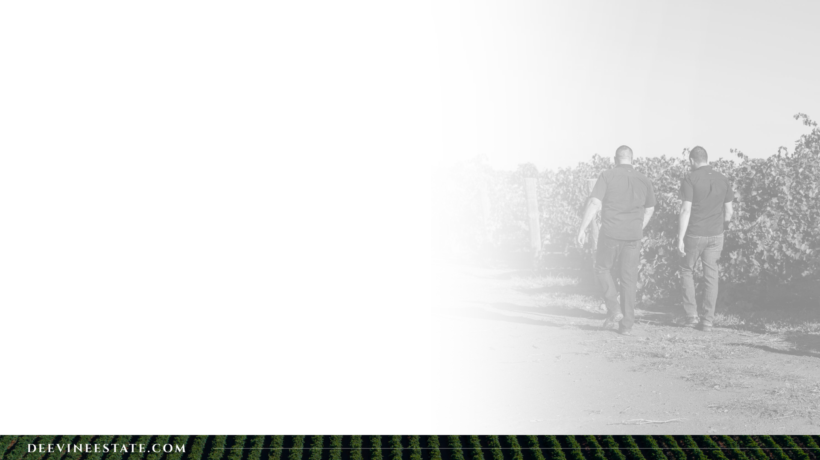
Our Regional Vineyards
The Riverina lies in the south-west region of New South Wales. The area consists of low-lying flood plains, warm to hot climate and an ample supply of water through irrigation that is diverted from the Murrumbidgee river.
The Riverina has been growing wine grapes since 1913 and is the second largest wine producing region in Australia. The area yields almost three-quarters of the entire annual wine volume of New South Wales.
The main soil type of the Riverina is red-brown earth deposited by ancient streams in the area. It is in these free-draining soils around Griffith that the Dee Vine Estate Vineyards are planted.

Slide 5
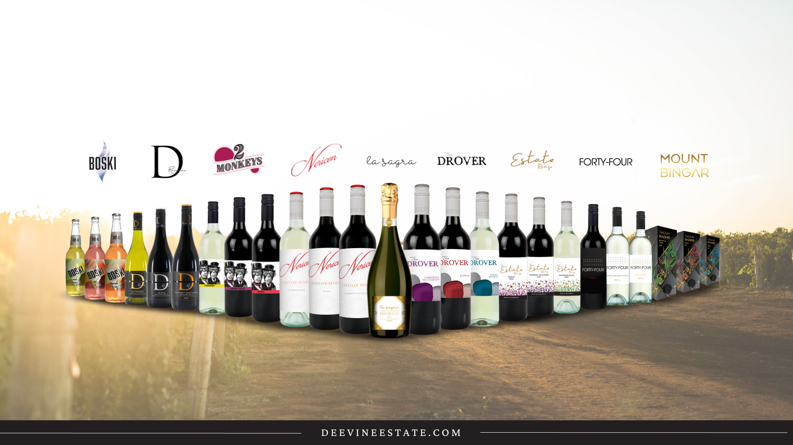
The Dee Vine Estate range currently features nine brands, including the popular Nericon, Estate Range, 2 Monkeys, Forty Four, D-Reserve, La Sagra, The Drover, boski and mount bingar

Slide 6
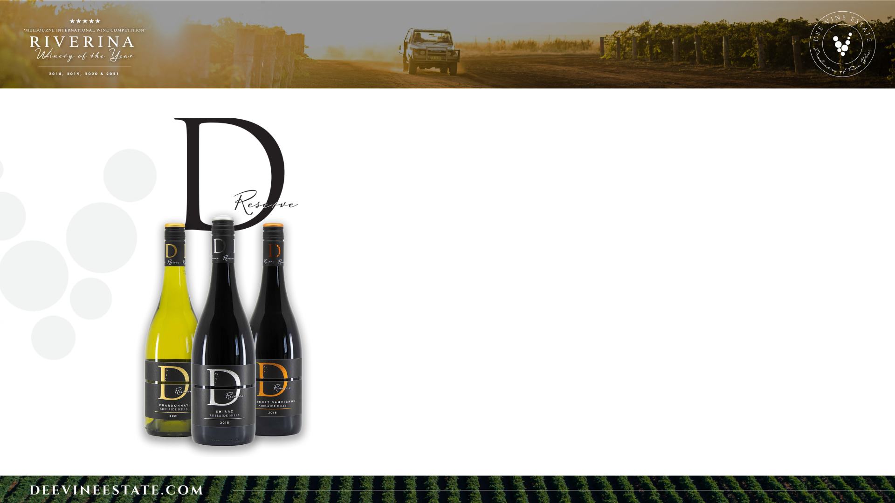
Our D Reserve range embodies the Italian concept of "reserve, reserve" which signifies a product that has been set aside for a special purpose. In the context of wine, "D Reserve" is a term used to describe a higher quality wine that has been crafted with meticulous care, resulting in a truly exceptional taste.
This idea inspired us to create our own D Reserve Cabernet Sauvignon in 2018, a wine that we believed deserved a special place in its own price bracket to reflect the time and effort taken in its production. Since then, our D Reserve range has grown to include three wines: Cabernet Sauvignon, Shiraz, and Chardonnay.. All three wines are crafted by our expert winemaking team using only the finest fruit sourced from the prestigious Adelaide Hills in South Australia, resulting in a bold and unique taste that is smooth on the palate.
Unsurprisingly, our D Reserve wines have been a hit with wine enthusiasts of all ages and levels of experience, thanks to their exceptional quality and attention to detail. Whether you're a seasoned wine connoisseur or simply looking for a truly special wine to enjoy on a special occasion, our D Reserve range is sure to impress.
RANGE:
2019 D-RESERVE SHIRAZ
2018 D-RESERVE CABERNET SAUVIGNON
2021 D-RESERVE CHARDONNAY

Slide 7
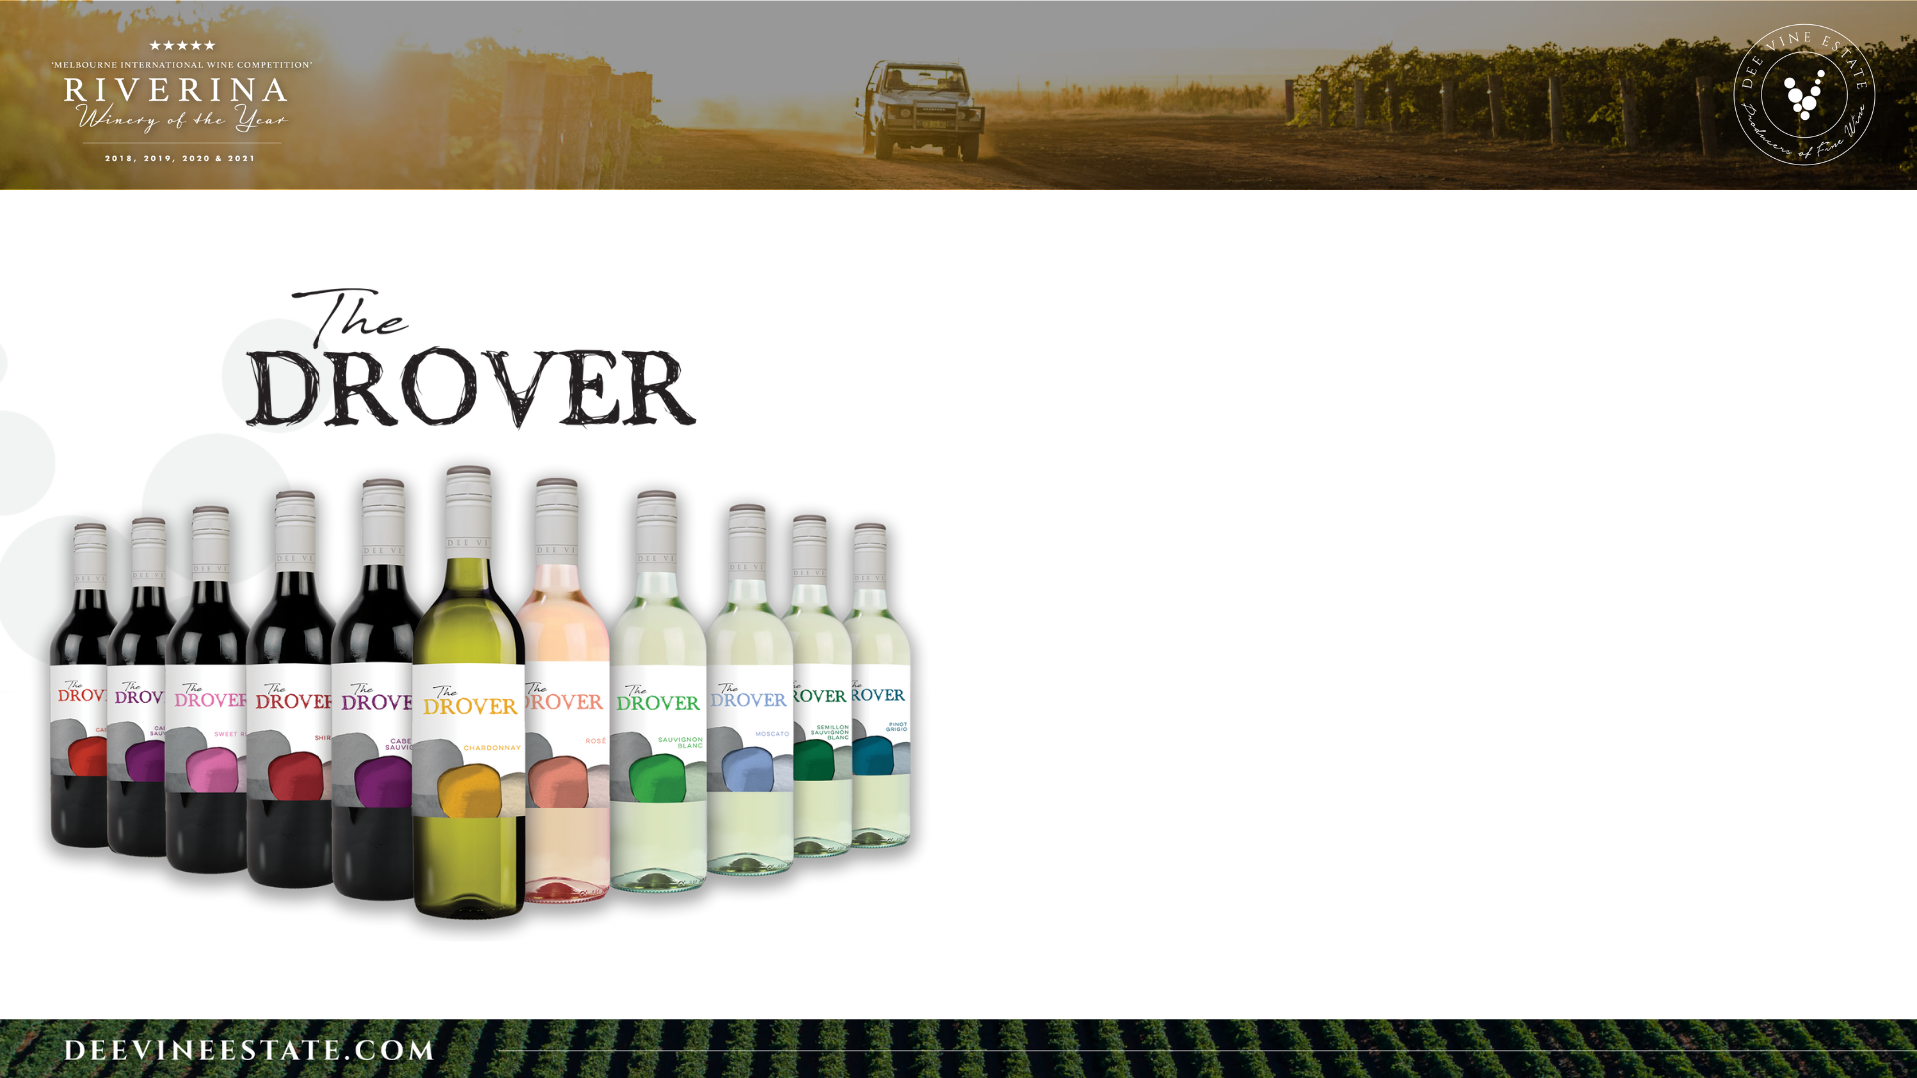
Our Drovers range was named after the intrepid drovers who would move their flocks of sheep from vineyard to vineyard, allowing them to graze beneath the vines during the arid months of the year. This rugged and adventurous spirit is reflected in the character of our wines, which are designed to capture the essence of the Australian Outback.
Bold and robust, The Drover is a classic wine that embodies the rugged beauty and untamed spirit of the land. Crafted from carefully selected grapes, our winemakers use traditional techniques to create rich, complex flavors that are sure to leave a lasting impression on your palate.
Whether you're enjoying a glass of The Drover after a long day of work or sharing a bottle with friends around the campfire, our wines are the perfect accompaniment to any occasion. So why not raise a glass to the adventurous spirit of the drovers and enjoy a taste of the Outback with our Drovers range?
RANGE:
2022 SWEET RED
2022 SAUVINGNON BLANC
2022 SEMILON SAUVINGNON BLANC
2022 MOSCATO
2022 PINK MOSCATO
2022 PINOT GRIGIO
2022 CHARDONNAY
2022 ROSE
2021 SHIRAZ
2021 SHIRAZ CABERNET
2021 CABERNET SAUVIGNON

Slide 8
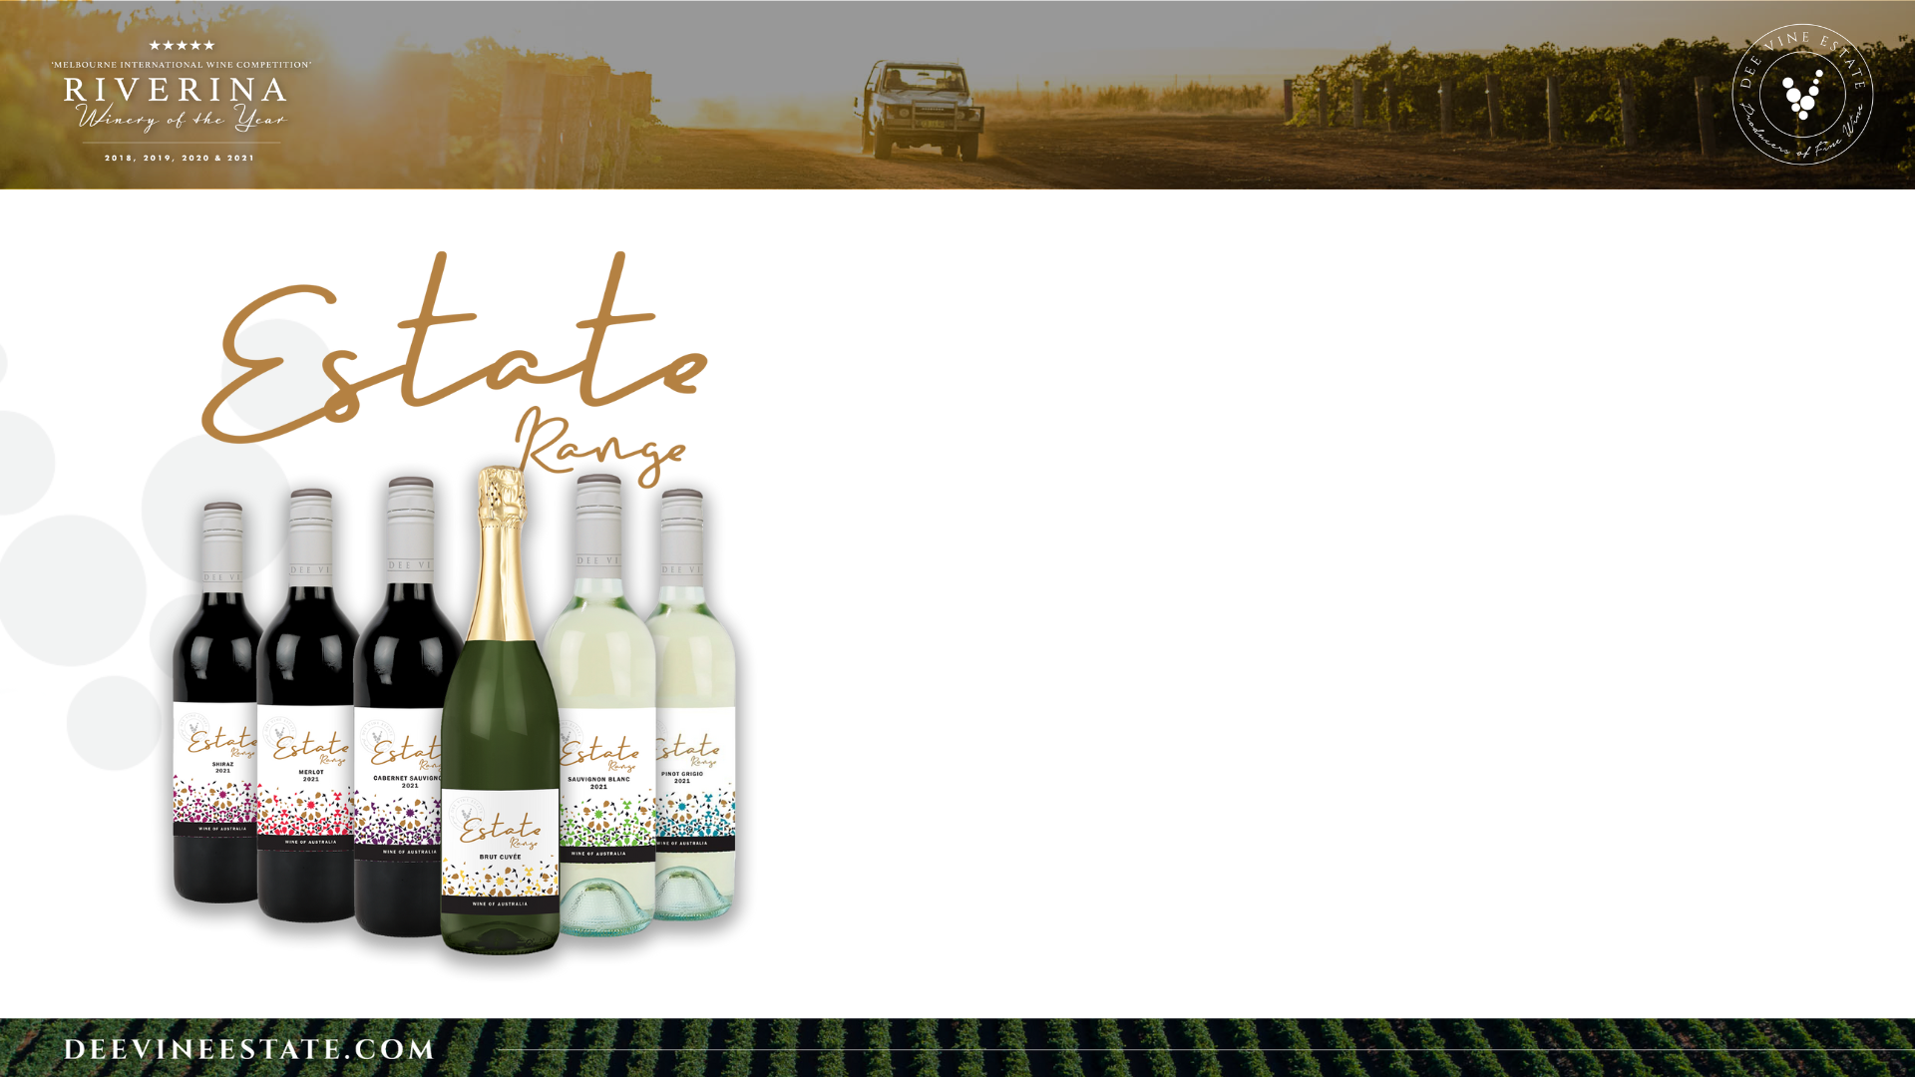
Our Estate Range is a tribute to our Italian heritage and the timeless Italian saying, "Il vino della gamma aziendale è buono," meaning "The wine from the company's range is good." We take great pride in selecting only the finest grapes from the Riverina region in Australia to create our Estate Range, using a combination of traditional and modern techniques to craft exceptional red and white wines.
Our range now consists of six tasteful and affordable varieties, each one carefully crafted with care and passion to deliver a taste that will leave you wanting more. With every bottle of our Estate Range, you can expect to enjoy a wine that has been made with the utmost attention to detail, from grape to bottle.
It's no surprise that our Estate Range has been well received by wine enthusiasts and casual drinkers alike. Our commitment to quality and passion for winemaking shines through in every bottle, resulting in a range that is both approachable and refined. Whether you're a connoisseur or simply looking for a delicious and affordable wine to enjoy with friends and family, our Estate Range has something for everyone.
RANGE:
ESTATE RANGE BRUT CUVÉE
2022 ESTATE RANGE PINOT GRIGIO
2021 ESTATE RANGE CABERNET SAUVIGNON
2021 ESTATE RANGE SHIRAZ
2022 ESTATE RANGE SAUVIGNON BLANC
2021 ESTATE RANGE MERLOT

Slide 9
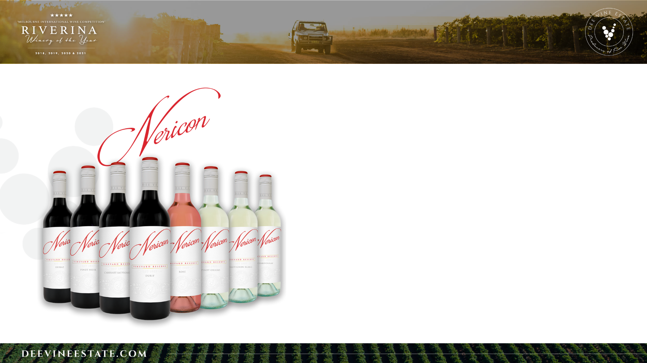
The Nericon line of wines pays tribute to the origins of our venture in 1956, when two brothers, Michele and Domenico Scarfone, migrated from Southern Italy and established the Dee Vine Estate winery in Nericon, a small town in the Riverina region of Australia.
The following year, they planted their first vines with the aim of producing traditional Italian table wines for the Australian market. Today, three generations later, Dee Vine Estate is a renowned winery, owning and operating numerous vineyards in the local area.
Our Nericon range is a nod to our beginnings, a classic label that embodies quality and timeless sophistication. Featuring eight varieties, including some of our best-sellers, the Nericon range is a well-known brand that has stood the test of time for our valued consumers.
With every bottle of Nericon, you can taste the passion and dedication that has gone into making these wines. From our family to yours, we hope that you will enjoy the rich history and tradition that is embedded in every sip of Nericon wine. Whether you're a seasoned wine connoisseur or simply looking for a quality wine to share with loved ones, the Nericon range is sure to impress.
RANGE:
2019 NERICON DURIF
2020 NERICON SHIRAZ
2021 NERICON PINOT NOIR
2019 NERICON CABERNET SAUVIGNON
2022 NERICON PINOT GRIGIO
2022 NERICON SAUVIGNON BLANC
2022 NERICON ROSÉ
2021 NERICON CHARDONNAY

Slide 10
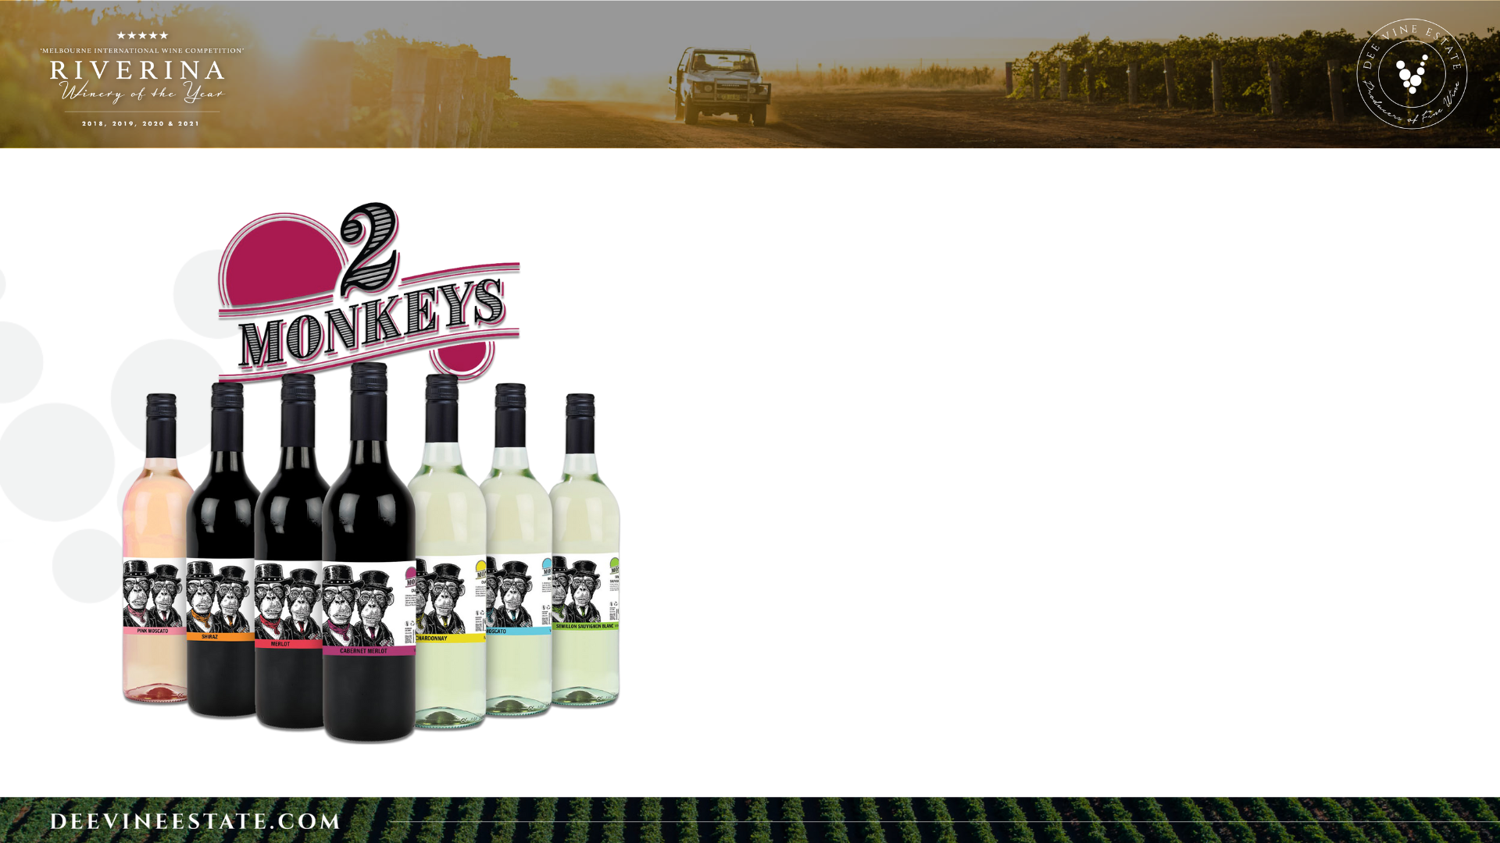
Discover the playful and vibrant world of Two Monkeys, the beloved brand that has taken the wine industry by storm since its launch in 2012. With a range of seven distinct and high-quality wines, Two Monkeys brings the best of the Riverina Region to your table, without breaking the bank.
What sets Two Monkeys apart is their bold, witty and unapologetic label, sure to spark conversations and add a touch of fun to any gathering. It's no wonder that the brand has quickly become a fan favourite, thanks to its unique personality and exceptional taste.
Two monkeys pays homage to the Italian heritage of the Directors Adrian Bianchini and Fernando Rombola. These wines represent the playful side of their personalities, and when combined with traditional Italian winemaking techniques, results in a truly one-of-a-kind taste.
RANGE:
2022 SEMILLON SAUVIGNON BLANC
2021 SHIRAZ
2022 PINK MOSCATO
2022 MOSCATO
2022 CHARDONNAY
2021 MERLOT
2021 CABERNET MERLOT

Slide 11
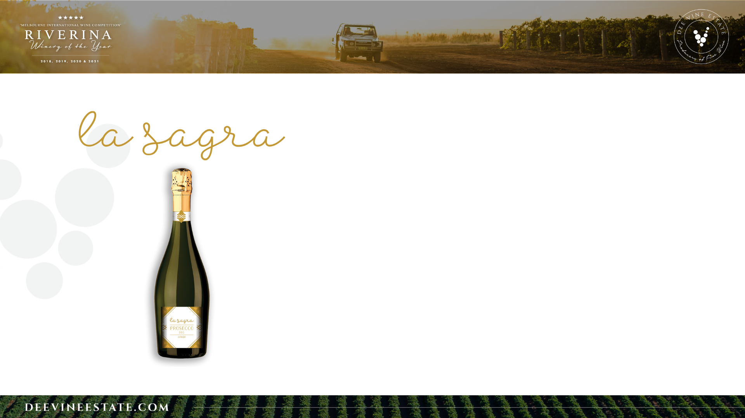
La Sagra Prosecco is a brand with a rich history and a passion for creating exceptional sparkling wines that delight the senses. The brand takes its name from the Italian word "sagra," which means festival or celebration. It's a name that perfectly captures the essence of the wine - a drink that's perfect for any occasion.
The story of La Sagra Prosecco begins in the sparse red dirt of the Riverina. The region is renowned for producing some of the finest Proseccoso, and La Sagra is no exception.
La Sagra Prosecco is more than just a wine; it's a celebration of life and all the special moments that make it worth living. Whether you're enjoying a glass of La Sagra Prosecco with friends or sipping it alone, the wine transports you to the countryside and fills you with a sense of joy and celebration.
In the end, La Sagra Prosecco is a brand that's rooted in tradition but always looking to the future. It's a brand that's committed to producing exceptional sparkling wines that are both delicious and sustainable. So raise a glass to La Sagra Prosecco and celebrate the joy of life with every sip.
RANGE:
PROSECO D.O.C

Slide 12
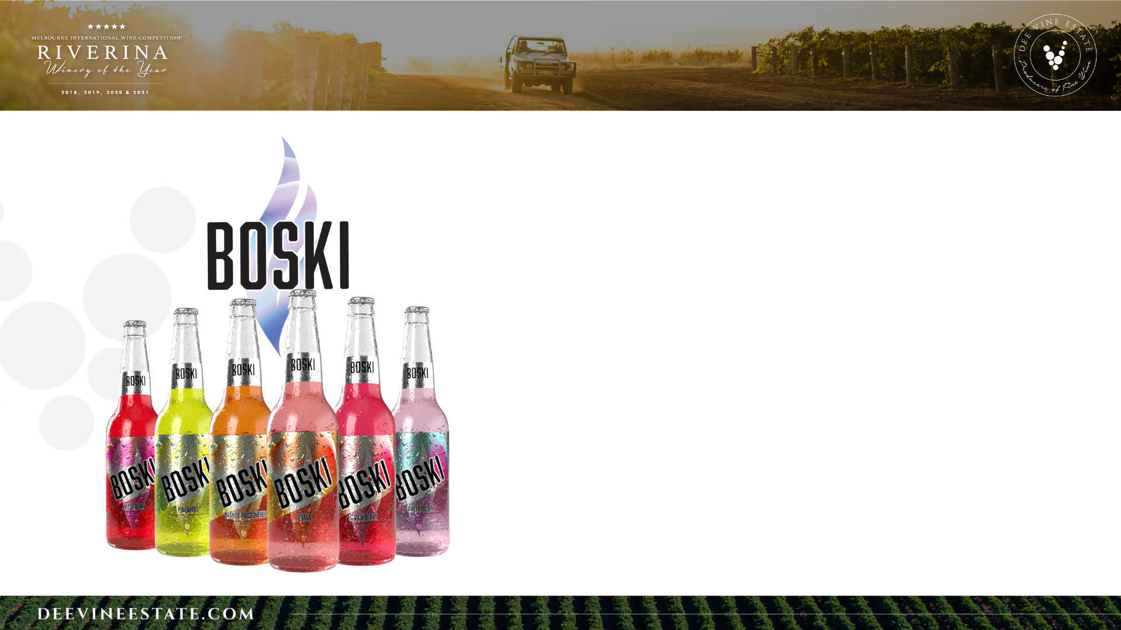
Boski
Dee Vine Estate has brought a whole new level of excitement to the premixed drink market with our Boski range! Derived from the Polish word for delicious, the name
Boski perfectly captures the sweet and natural flavors of our grape wine drinks.
With six tantalizing varieties to choose from, including refreshing Watermelon, and fruity Passionfruit, the hardest decision will be picking just one. Each Boski is crafted with care and precision to ensure that every sip is bursting with flavor and refreshment.
Whether you're sipping Boski by the pool or sharing a bottle with friends at a barbecue, our drinks are the perfect way to add a touch of fun and flavor to any occasion. So why not try our Boski range today and discover why it's quickly becoming a favorite among wine lovers everywhere?
RANGE:
GUAVA
STRAWBERRY
RASPBERRY
PINEAPPLE
WATERMELON
ORANGE PASSIONFRUIT

Slide 13
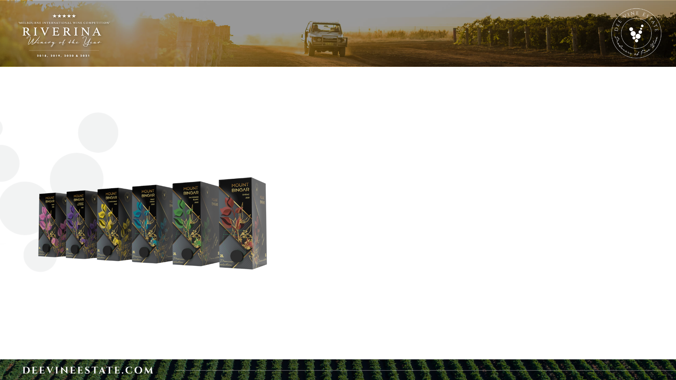

Slide 14

Fun Facts
- Our global reach is extensive, with 40 unique varieties exported to more than 10 countries worldwide.
- We have crushed over 20,000 tonnes of grapes during our 2023 vintage, ready for the winemaking process.
- Our team is the backbone of our operation, with over 40 employees working year-round and 70 during the busy vintage season.
- We're proud to maintain a consistent export volume, with an average of 20 containers per month shipped to various destinations around the world.

